Slide 1
Recommended design changes in Dolphin Browser for creation of bookmark folder
Note: Please download this PowerPoint file and run it in slideshow mode to see the functional prototype.

Slide 2
Outline
Current task flow
Recognition of design issues
Design recommendations
Design wins of recommended design

Slide 3
I. Current task flow
Taps indicated by highlighting the screen area in orange color

Slide 4
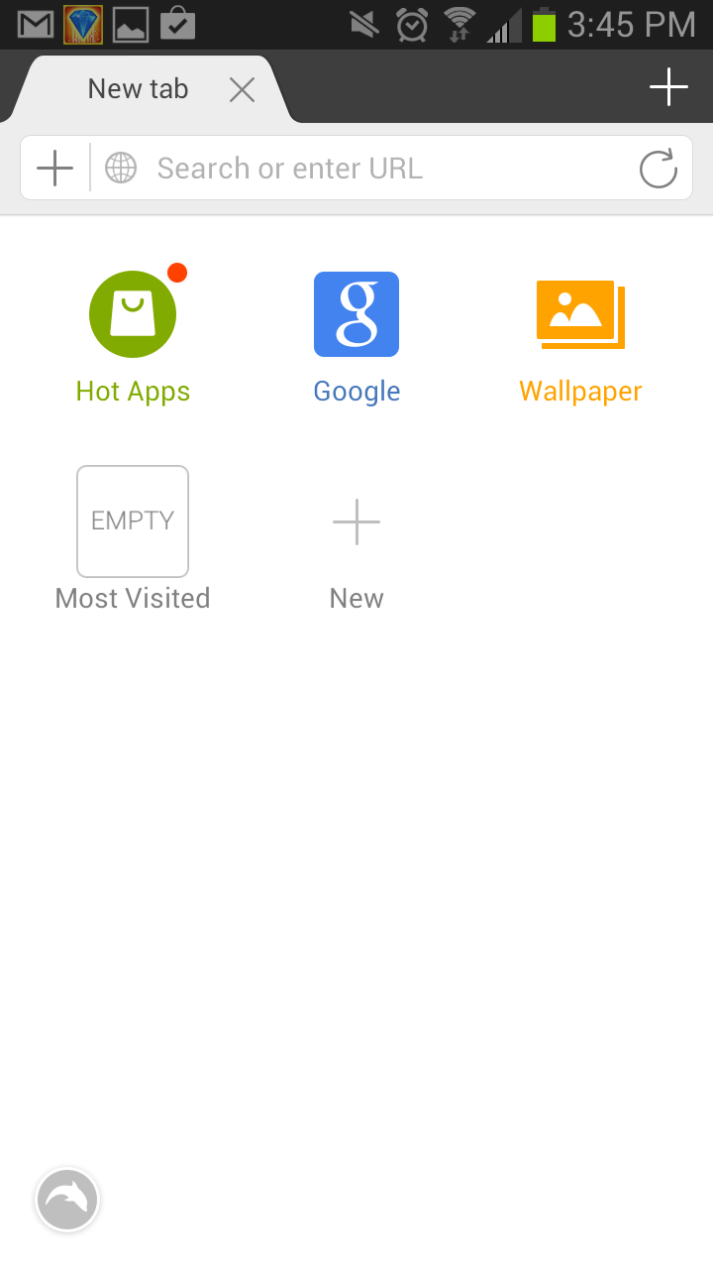

Slide 5
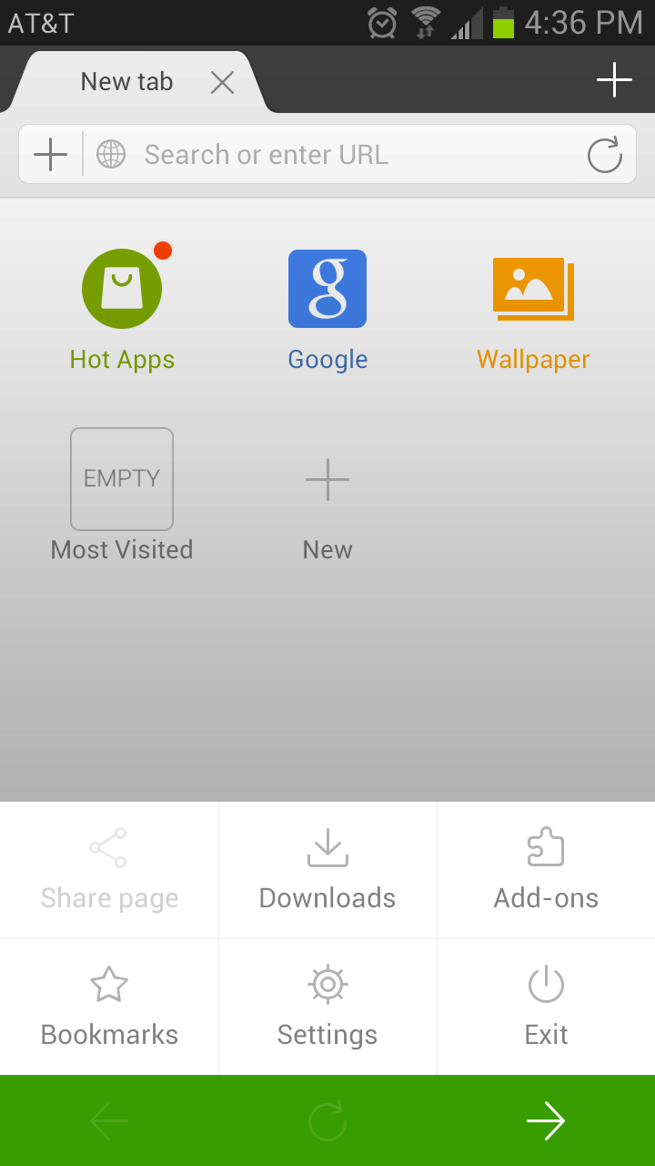

Slide 6
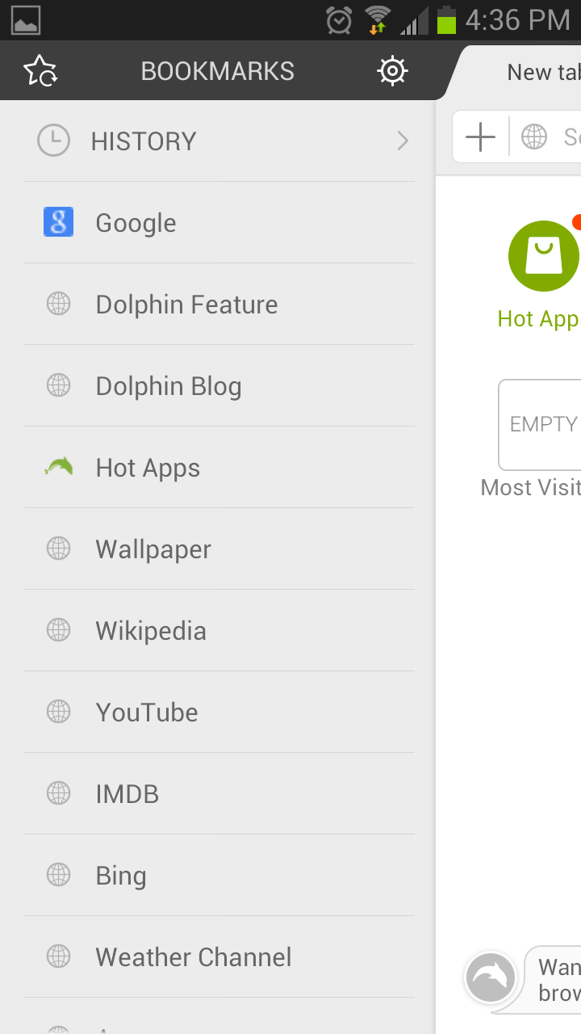

Slide 7
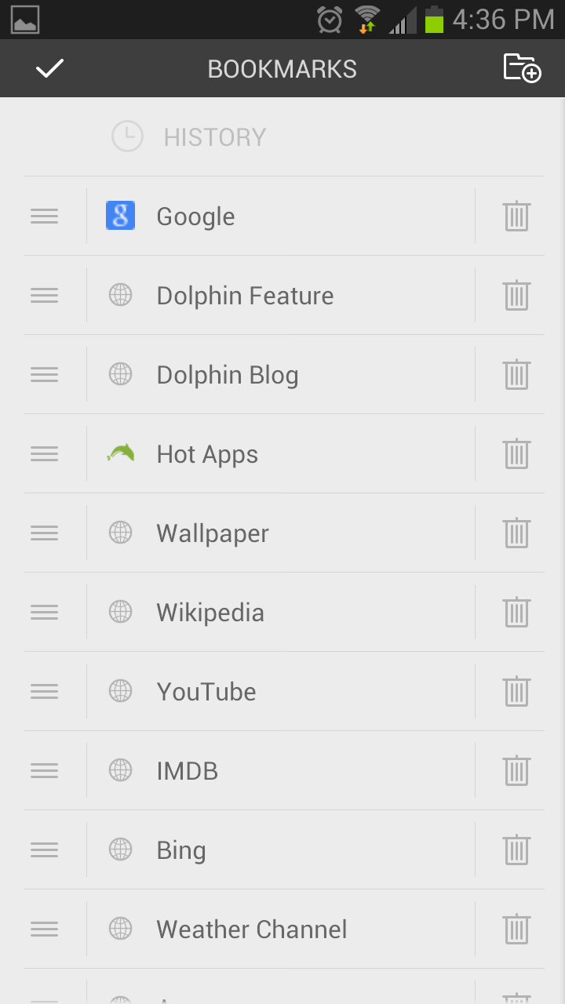

Slide 8
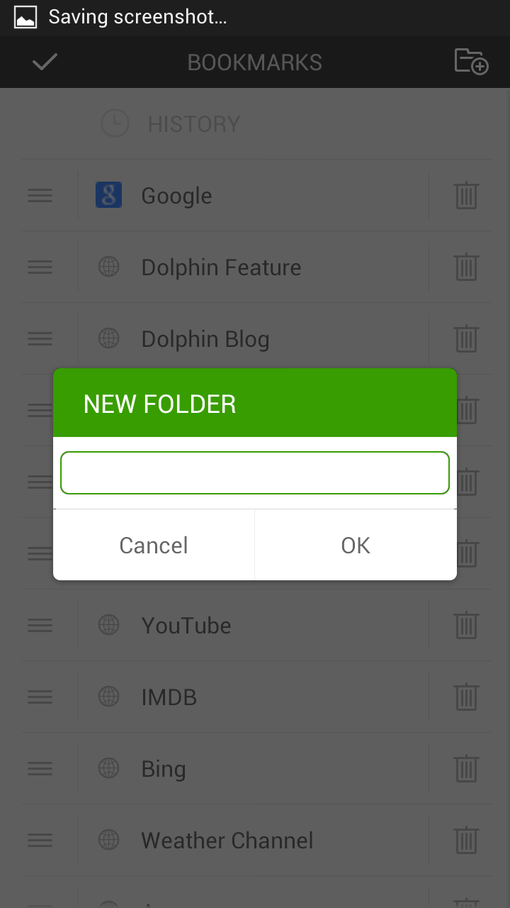

Slide 9
II. Design issues with current task flow
Currently the ‘create new bookmark folder’ is buried in levels of menu
Current way of accessing the function is unintuitive
Create new bookmark folder icon can be missed
Current task flow needs the user create a folder before bookmarking, thus inefficient
3 out of four participants tested failed at this task

Slide 10
III. Recommended Design changes

Slide 12
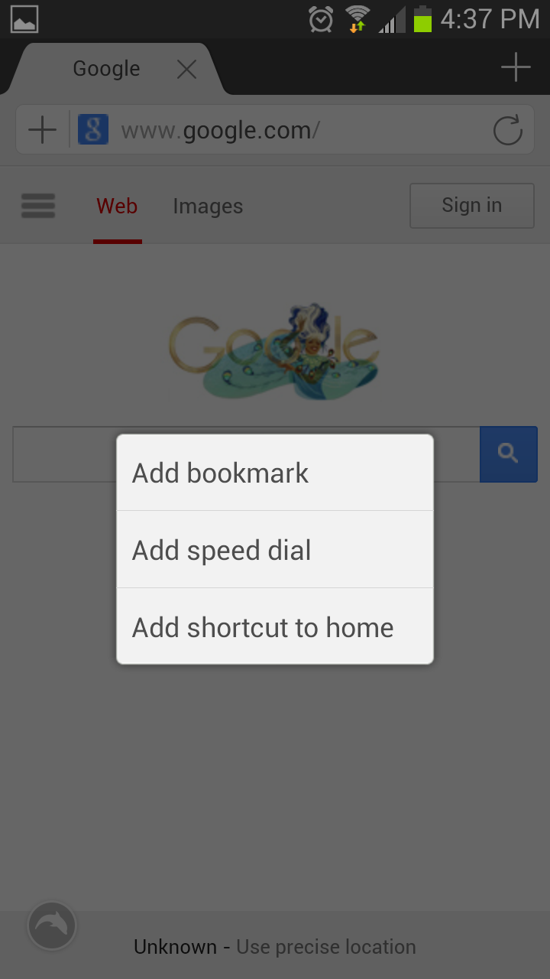

Slide 13
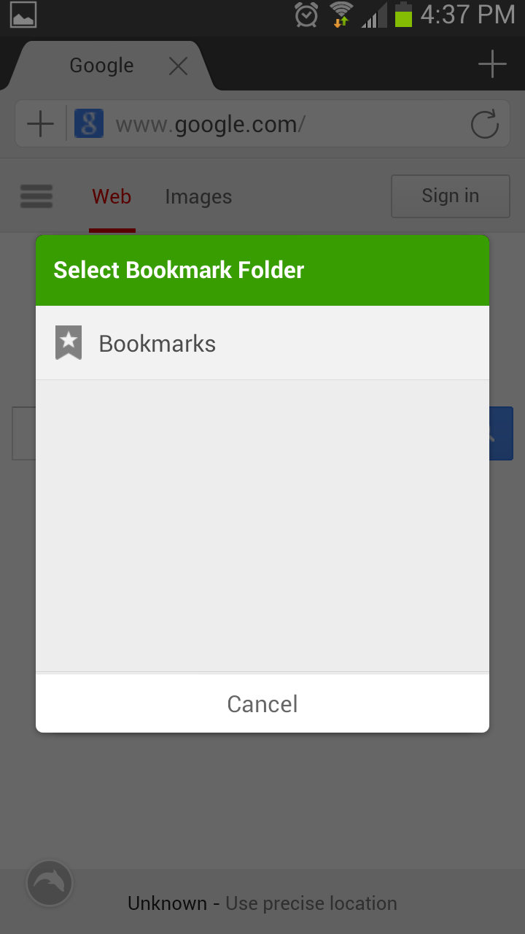

Slide 15
IV. Design wins
The ‘create bookmark folder’ is located along with bookmarking function
The function is upfront
With this redesign, the user can create a new bookmark folder as they are bookmarking a page

